Slide 1
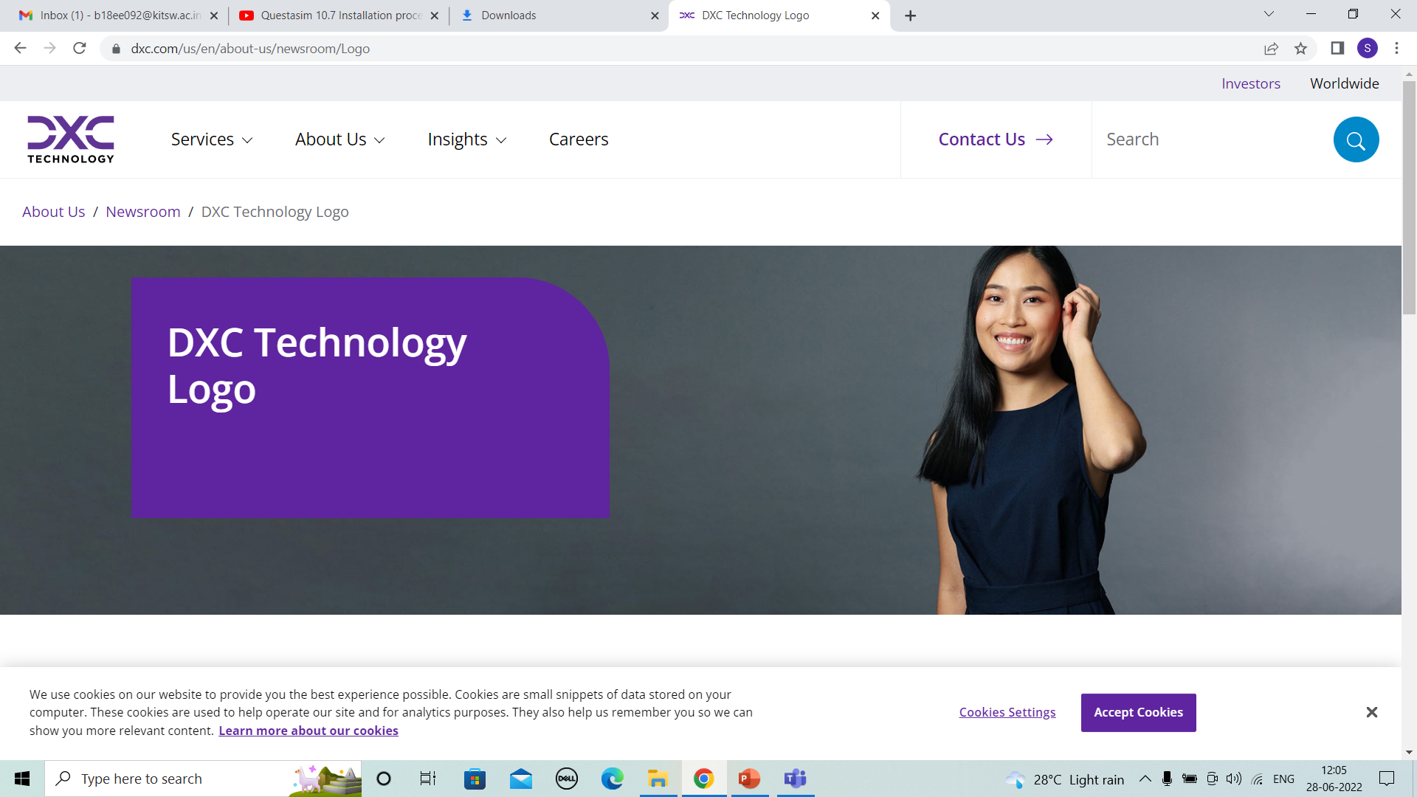
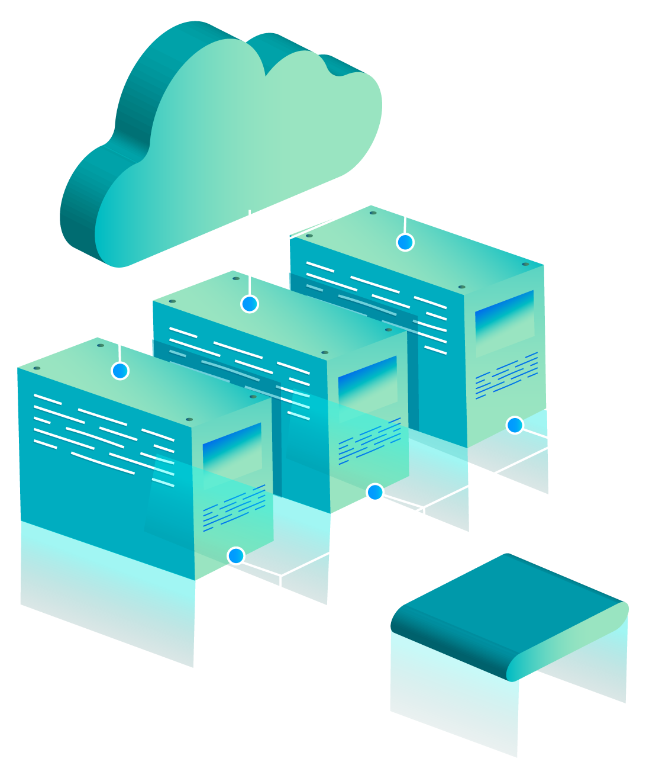
DXC REALTIME PROJECTS
PRESENTED BY
NAME :SUPRIYA BHARATHA
Reg No: DXC262AB1211

Slide 2
CONTENTS
Project Architecture.
Resources used in project.
Process.
Explanation of each Task.
Result.

Slide 3
PROJECTS
PROJECT 1: Smart Vehicles
PROJECT 2: AP Morgan Data Platform

Slide 4
PROJECT 1: Smart Vehicles

Slide 5
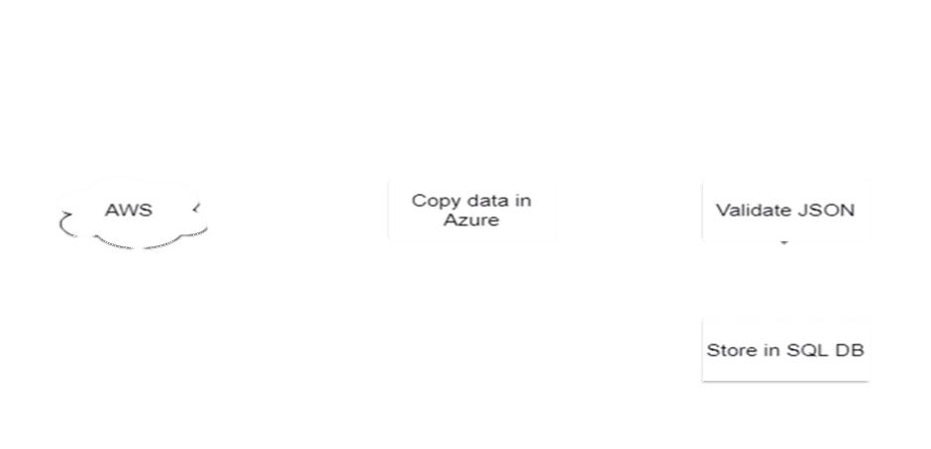

PROJECT OUTLINE
General Motors is one of the leading heavy vehicle manufacture company. To improve their service they are planning to rollout IoT new features based on IoT.
Sends Data in real time
vehicle
Azure Cloud

Slide 6
PROCESS
Create Azure Data Factory Account For Data pipelines
Create ADF Pipeline End to end pipeline with triggers enabled
Create Azure blob trigger logic
Create Azure SQL Server and Database
Add another pipelines for moving data from Staging to SQL DB

Slide 7
RESOURCES REQUIRED FOR PROJECT
Azure Data Factory
Azure Storage Account.
Azure SQL Database.

Slide 8
TASK 1: Create Azure Data Factory Account For Data pipelines
AZURE DATA FACTORY : Azure Data Factory is a Microsoft cloud service offered by the Azure platform that allows data integration from many different sources.
Steps to create Azure data factory:
Open azure portal and search for data factory and then select .
Click “+create” . Enter the details resource group , Name ,version and then review + create. Click on create.
Then deployment is done, in overview open azure data factory studio. The data factory is created.

Slide 9
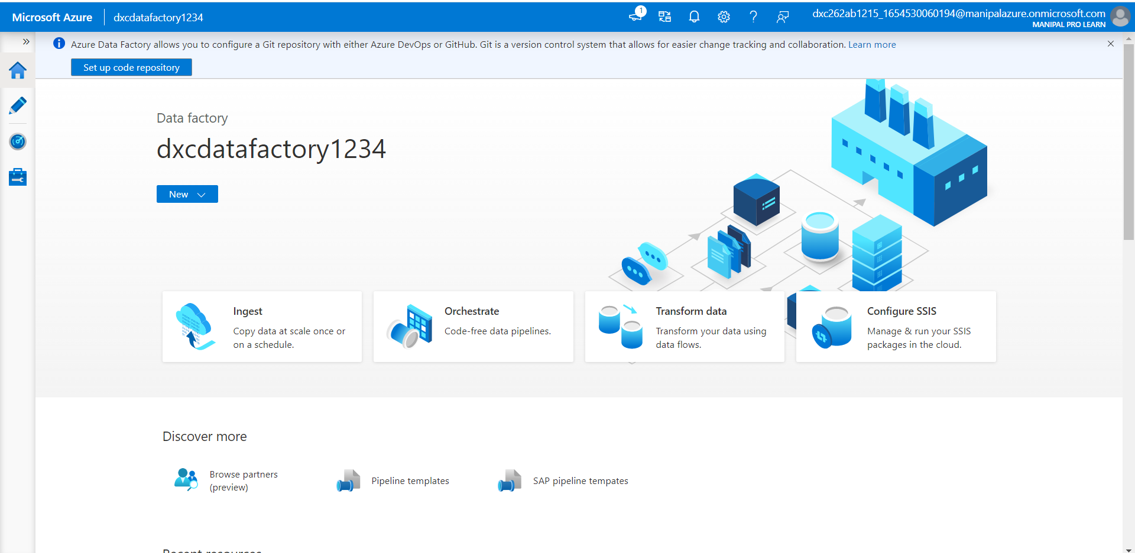

Slide 10
AZURE STORAGE ACCOUNT : An Azure storage account contains all of your Azure Storage data objects, including blobs, file shares, queues, tables, and disks.
Steps to create Azure storage account:
Open azure portal and search for storage accounts and then select .
Click “+create” . Enter the details resource group , Name and then review + create. Click on create.
The deployment is completed and then go to resource, To create containers ,we select containers on left side. To add new containers we use “+ container”.
Created containers of both sourceblob and destinationblob.
Uploaded the file in source blob.

Slide 11
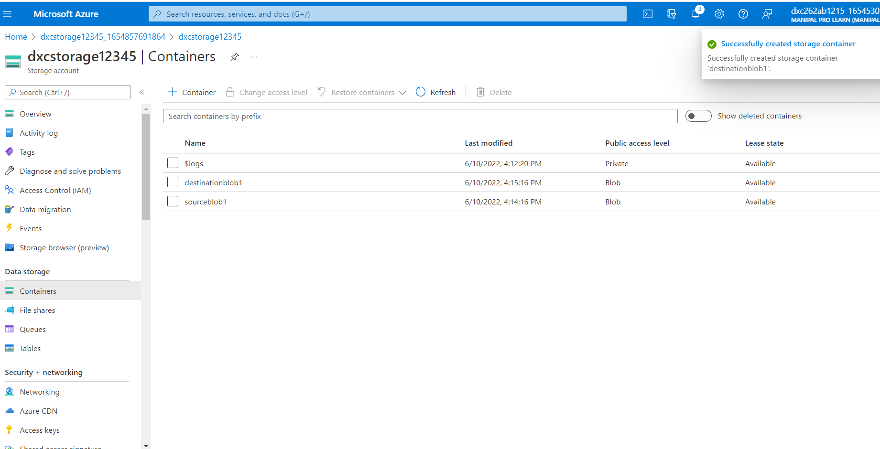

Slide 12
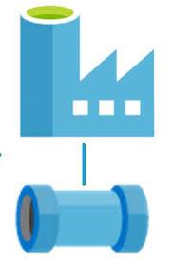
TASK 2: Create ADF Pipeline End to end pipeline with triggers enabled
SOURCE
(1000_companies)
DESTINATION
DATA FACTORY PIPELINE

Slide 13
Steps to create Pipeline in Azure data factory:
Open data factory, Click on ingest, we have to select built-in copy task.
“In source data store” add new connection for the storage account created. And browse the sourceblob1 and the file in it. Next to file format settings.
“In destination data store” add the connection and upload destination blob by browsing . Next to file format settings.
In settings the pipeline is shown and name it as required.
In summary we can observe the source and destination blob storage and then Next > Finish.

Slide 14
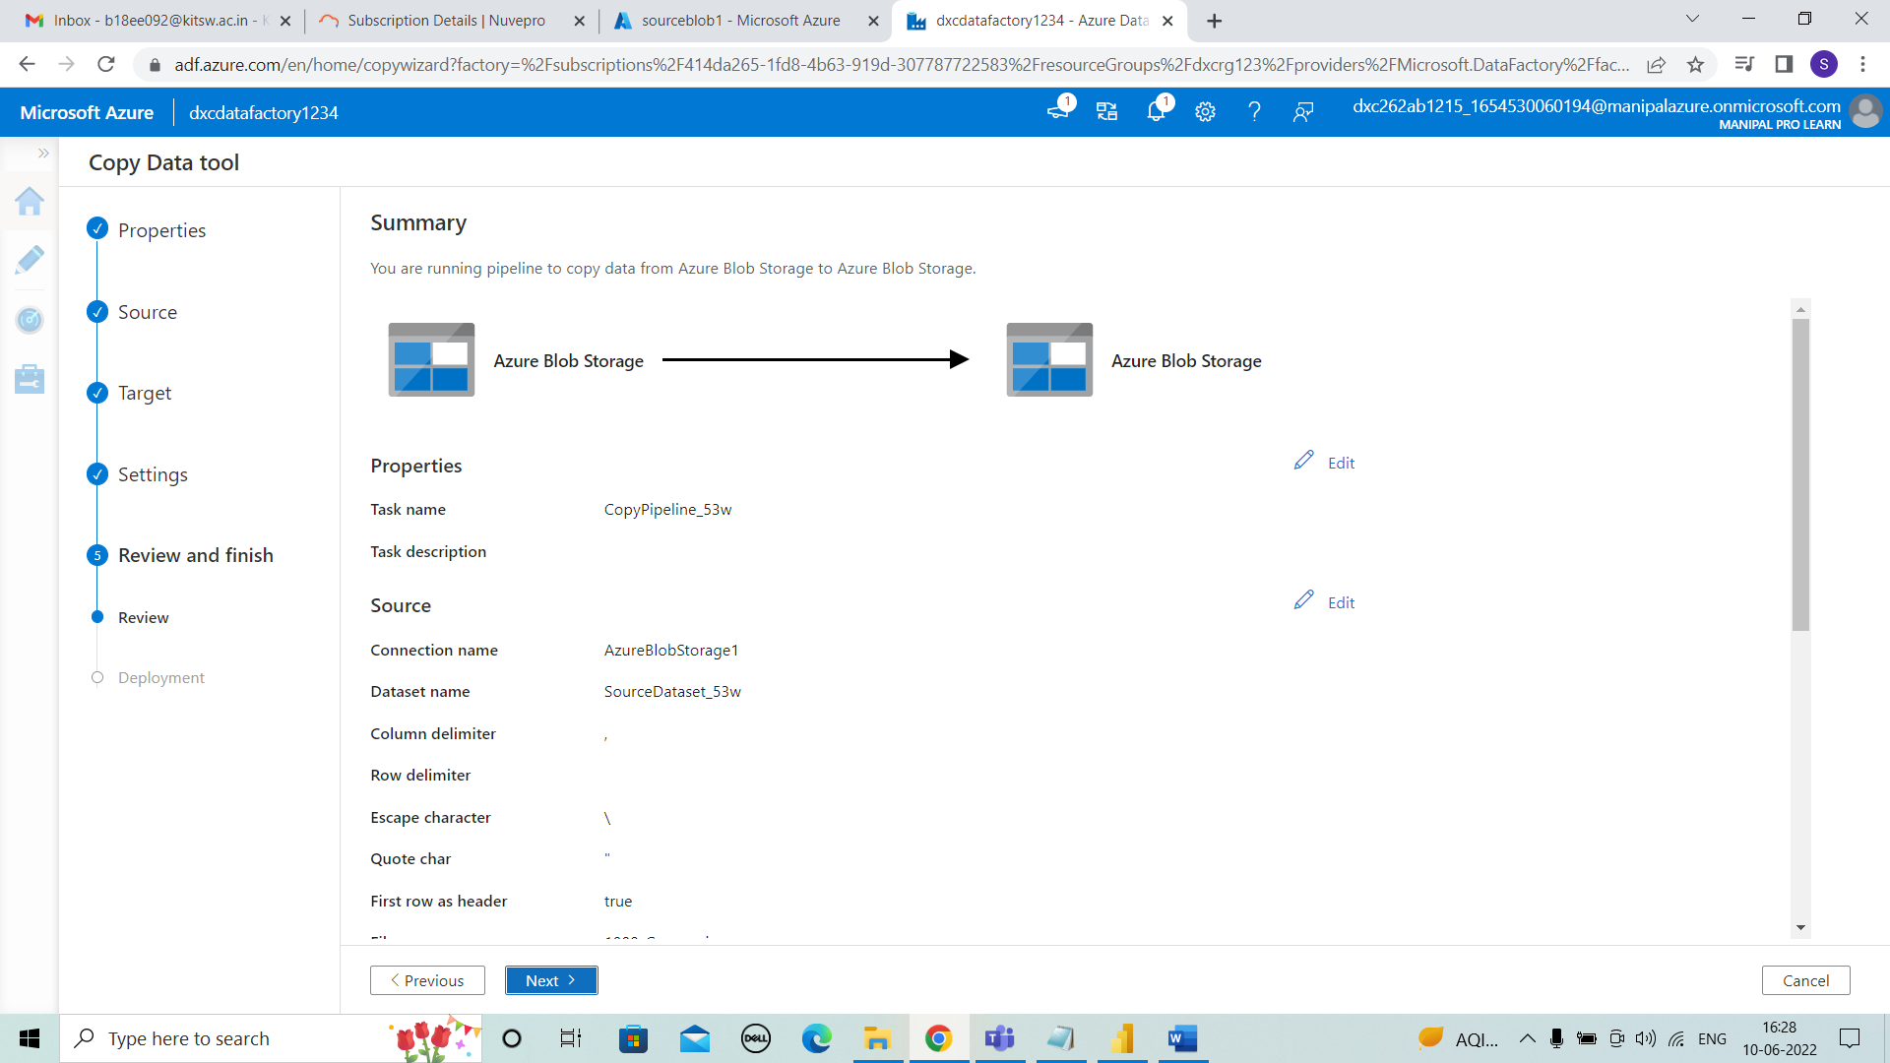

Slide 15
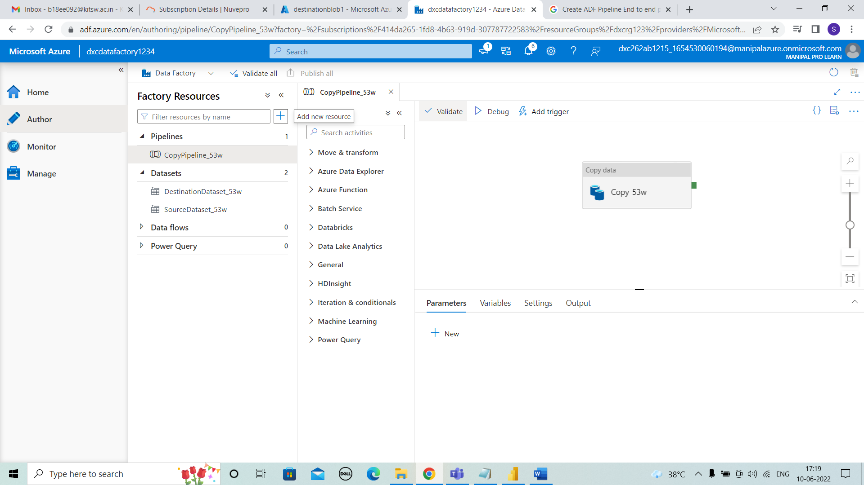
TASK 3: Create Azure blob trigger logic
Steps to create Azure blob trigger logic:
Select author to view the pipeline to trigger.
Validate the pipeline and publish .
Now the pipeline can be triggered by “trigger now” or schedule it by “New trigger”.
Select monitor to view the pipeline that is triggered and see the run successful.

Slide 16
TASK 4: Create Azure SQL Server and Database
Steps to create Azure SQL database:
Open azure portal and search for SQL database then select .
Under SQL databases, leave Resource type set to Single database, and select Create.
Enter the details of resource group, database name, Now select server.
Now for creating the server enter the server name and server admin login, password, confirm password.
Click on create after reviewing the details and the process is validating.
Deployment is done. And SQl data base is created.

Slide 17
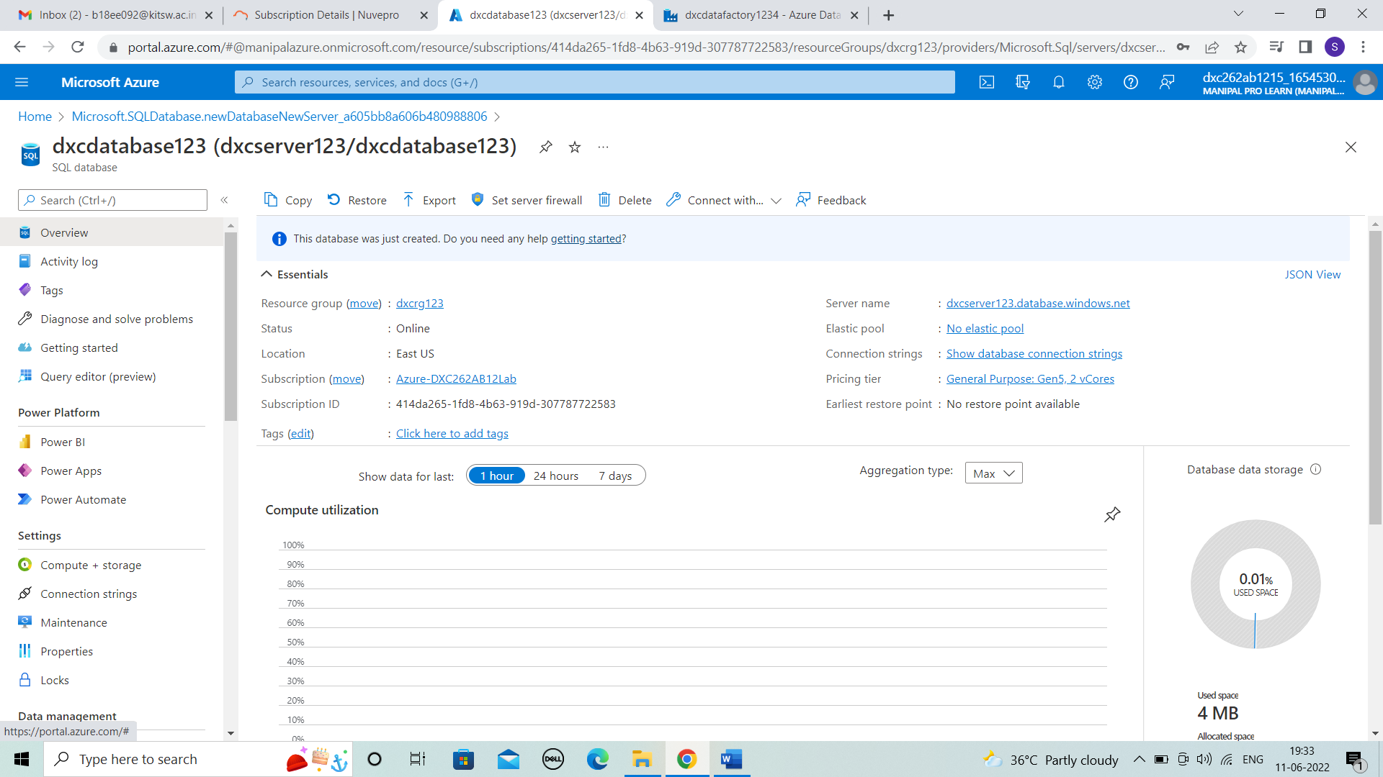

Slide 18

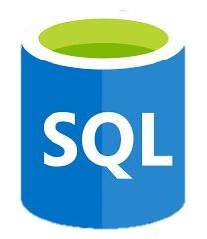
TASK 5: Add another pipelines for moving data from Staging to SQL DB
AZURE STORAGE
DATA FACTORY PIPELINE

Slide 19
Steps to create pipelines for moving data from Staging to SQL DB:
Open data factory, Click on ingest, we have to select built-in copy task.
“In source data store” connect with blob storage and browse the data . Next to file format settings.
“In destination data store” create new connection , by new linked service by entering the details of server name, database name and test connection . Then, click on create. Next to file format settings.
In settings the pipeline is shown and name it as required.
Enter the target details as the file that uploaded.
In summary we can observe the source and destination blob storage and then Next > Finish.
After creating the pipeline . In monitor the pipeline is viewed and it is succeeded.

Slide 20
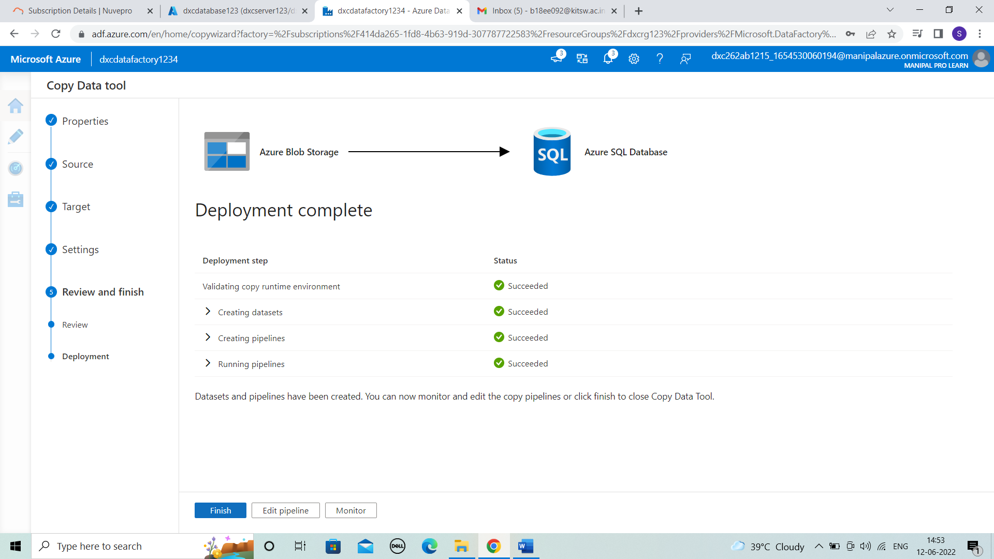

Slide 21
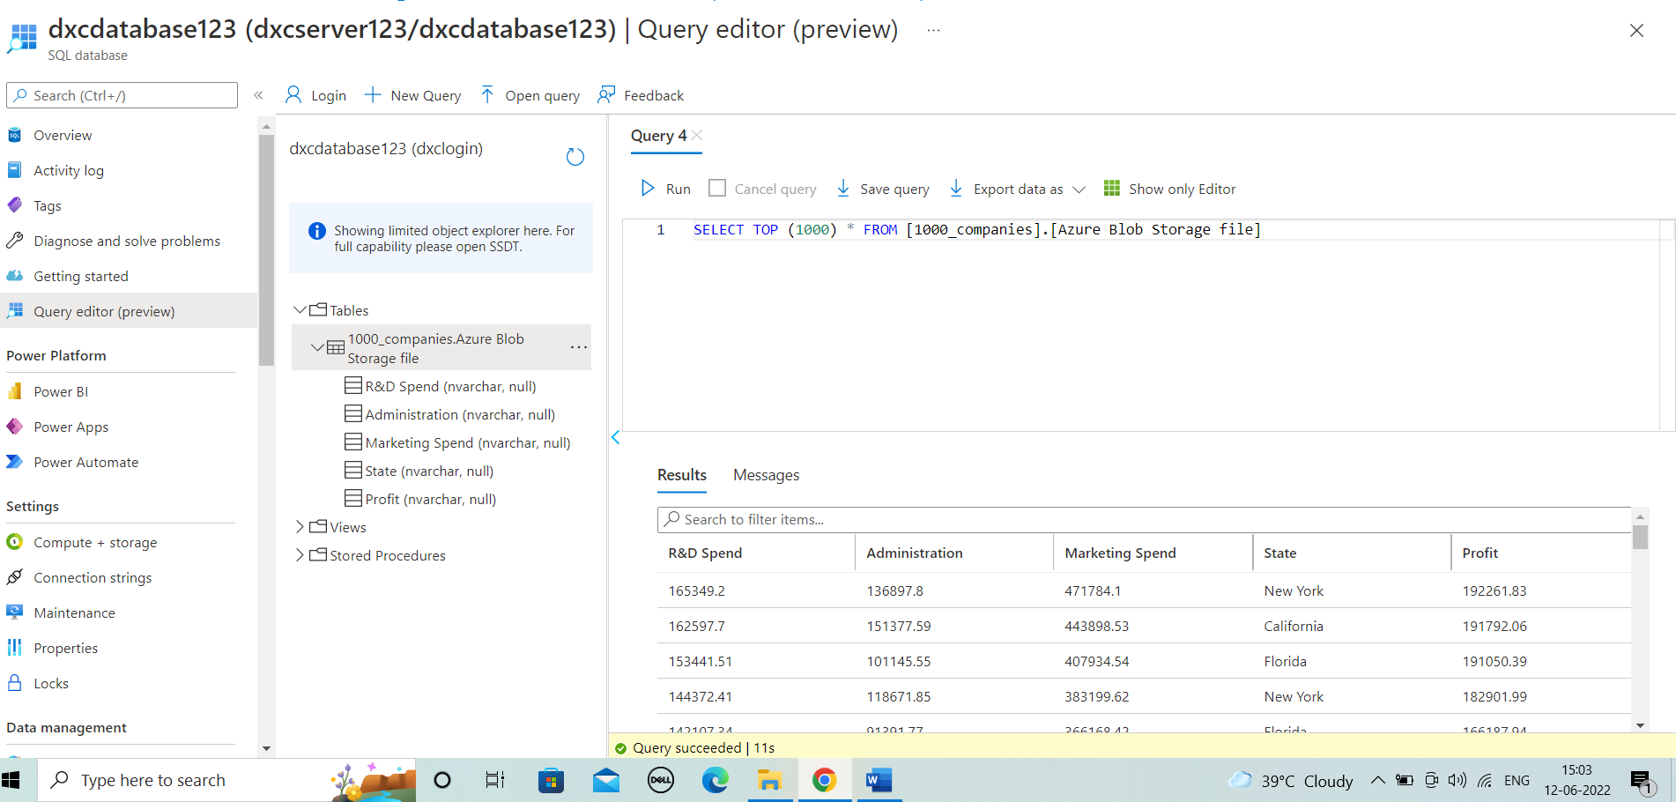
RESULT:
Coming to database to check the pipeline successful. Login with details shown and allow it by updating the firewall rules.
Run the data to view table .
We conclude it by “The Blob data moved and stored into SQL database by using pipelines in datafactory”.

Slide 22
PROJECT 2: AP Morgan Data Platform

Slide 23
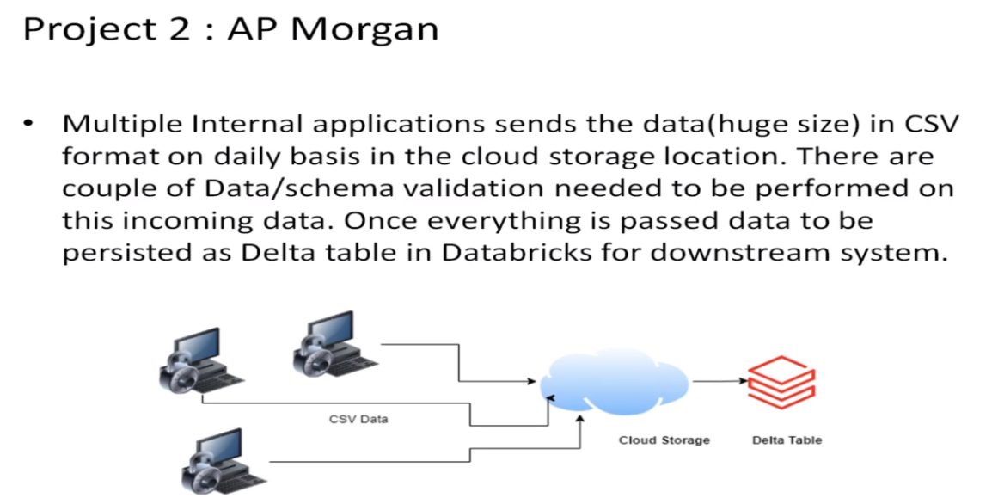
PROJECT OUTLINE
Multiple Internal applications sends the data (huge size) in CSV format on daily basis the cloud storage location. There are couple of Data/schema validation needed to be performed on this incoming data. Once everything is passed to be persisted as Delta table in Databricks for downstream system.

Slide 24
PROCESS
Create a Databricks
Create Cluster in Azure Databricks
Add notebook in Databricks and Implement the Business Logic
Azure Data Factory For AP Morgan
Create Azure Databricks Linked Service in ADF

Slide 25
RESOURCES REQUIRED FOR PROJECT 2
Azure Data Bricks.
Azure Data Factory

Slide 26
TASK 1: Create Databricks
AZURE DATA BRICKS : Azure Data Bricks Azure Databricks is a fast, easy, and collaborative Apache Spark-based big data analytics service designed for data science and data engineering .
Steps to create Azure data bricks:
Open azure portal and search for Data bricks and select it. Click on + create.
enter the details of resource group, workspace name, pricing tier. And click on review + create.
In review + create check the details, validation is succeeded. And click on create.
Then deployment is done.
Go to resource and launch the workspace.

Slide 27
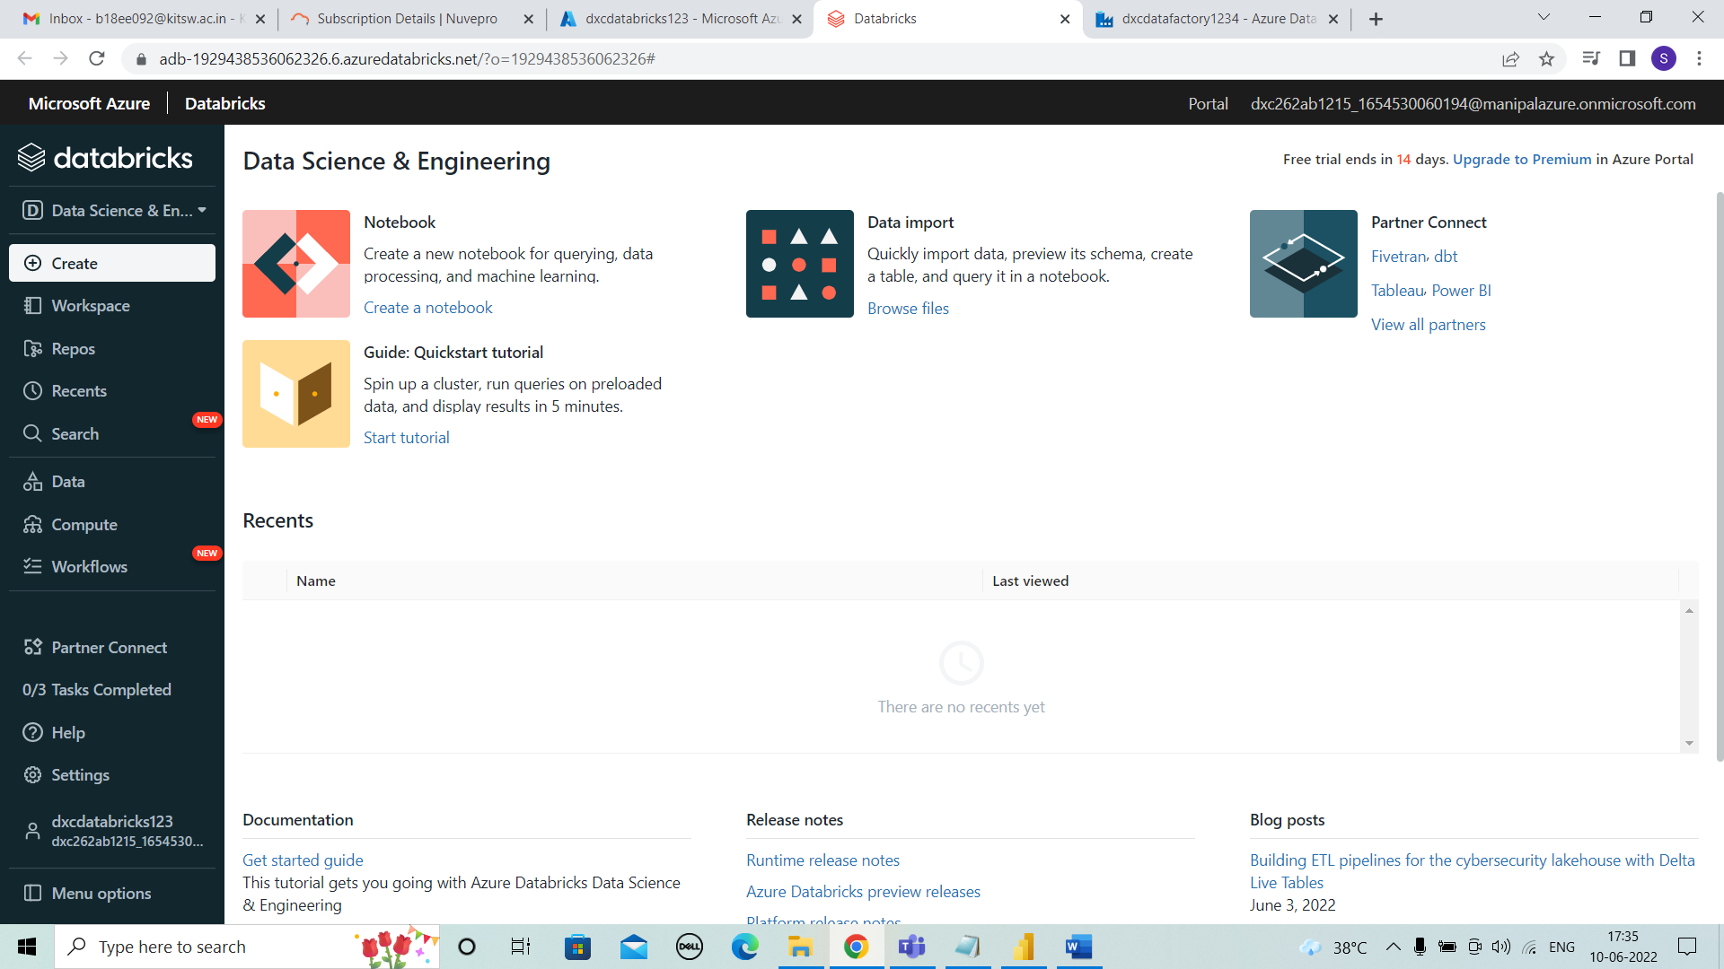

Slide 28
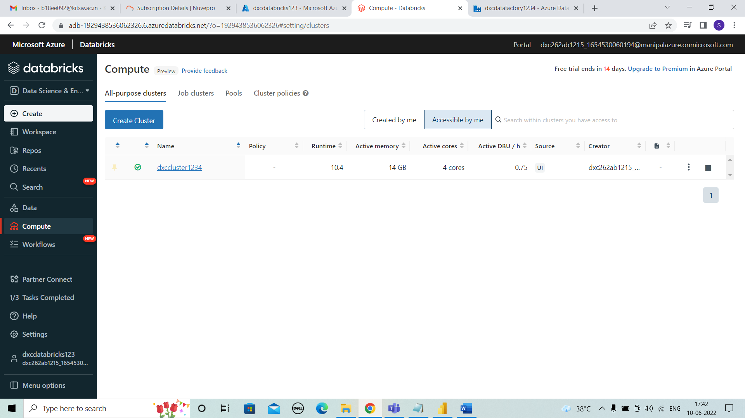
TASK 2: Create Cluster in Azure Databricks
For creating cluster, select compute on left side of tab shown and click on create cluster.
We need to enter the details of cluster name, cluster mode, runtime version, terminate time for new cluster .
Click on create.
And cluster is created.

Slide 29
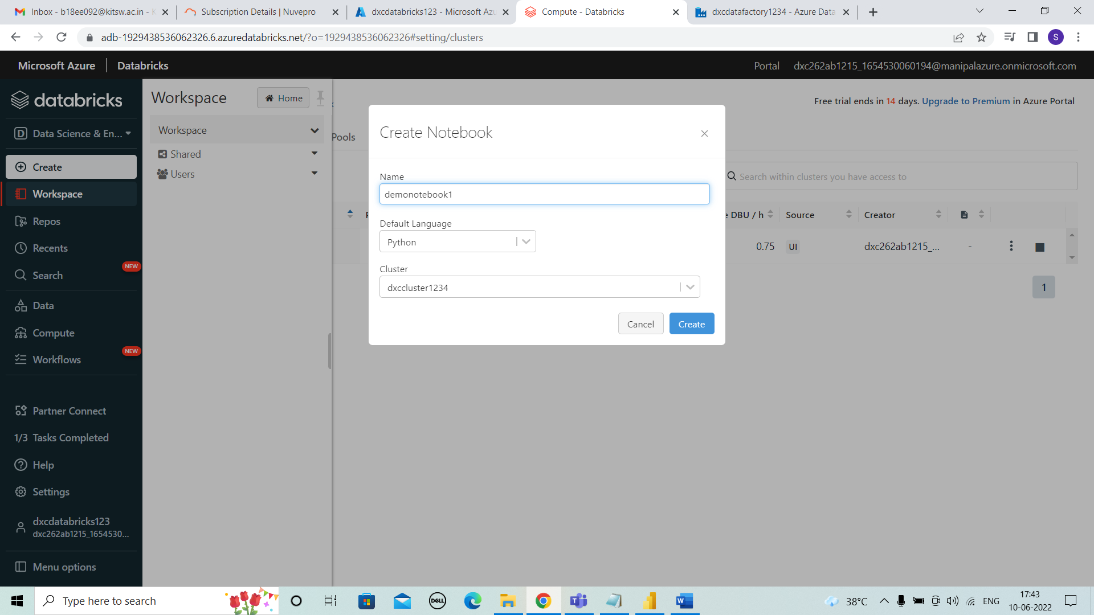
TASK 3: Add notebook in Databricks and Implement the Business Logic
For adding notebook into the databricks , we need to select workspace > Create > Notebook.
create a notebook by entering the name and click on create.

Slide 30
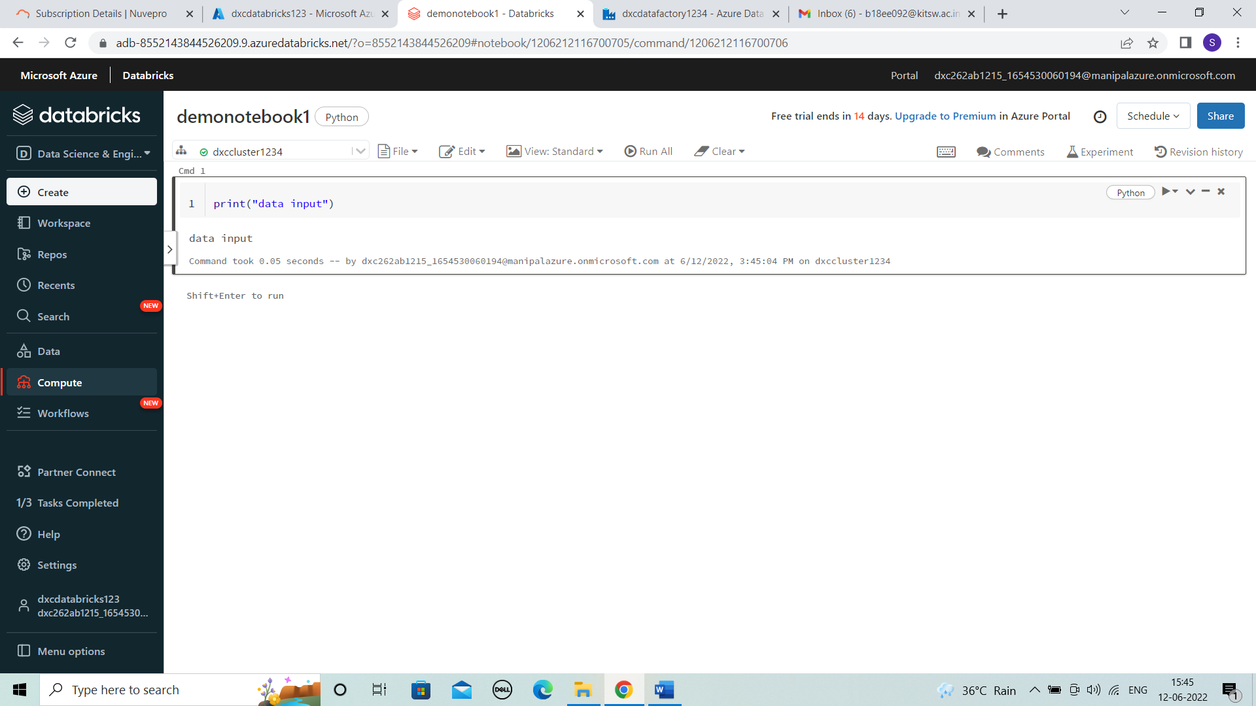
After notebook is created we can enter code Or the business logic required and run it as shown below and view the result and run time.

Slide 31
TASK 4: Azure Data Factory For AP Morgan
AZURE DATA FACTORY : Azure Data Factory is a Microsoft cloud service offered by the Azure platform that allows data integration from many different sources.
Steps to create Azure data factory:
Open azure portal and search for data factory and then select .
Click “+create” . Enter the details resource group , Name (Ap Morgan) ,version and then review + create. Click on create.
Then deployment is done, in overview open azure data factory studio. The data factory is created.

Slide 32
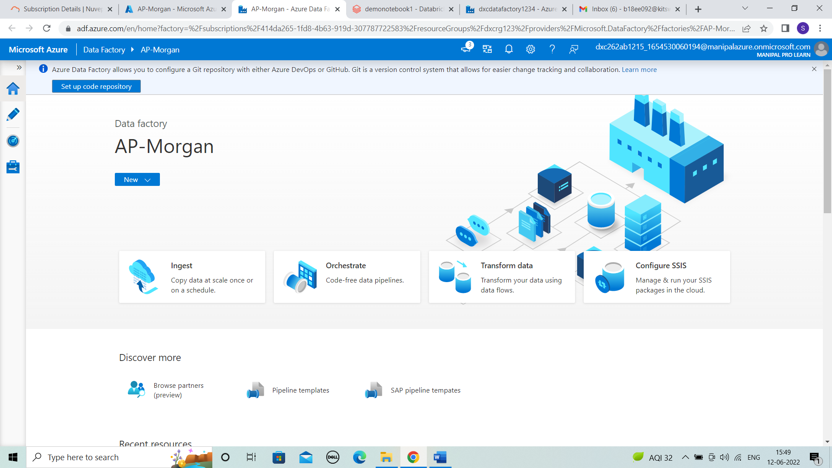

Slide 33

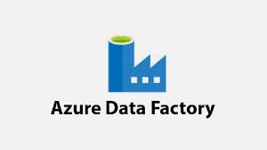
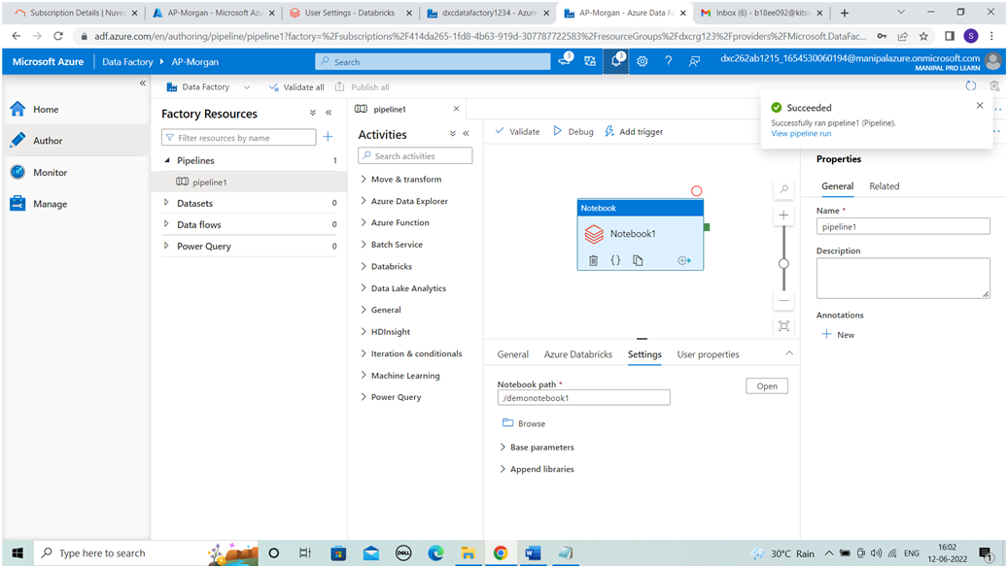
TASK 5: Create Azure Databricks Linked Service in ADF
LINKED SERVICE
AZURE DATA BRICKS
AZURE DATA FACTORY

Slide 34
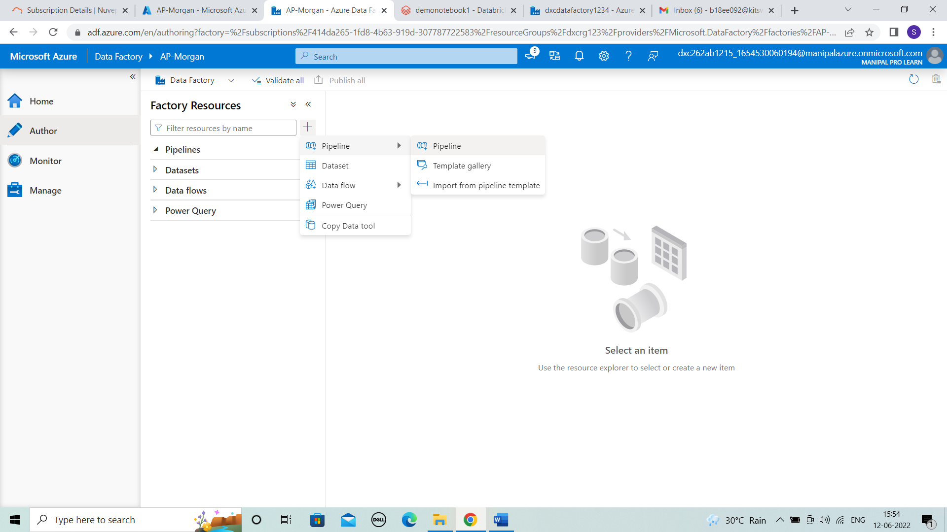
In author, click on “+” > pipeline to create a pipeline that will be used to connect Data Bricks notebook with Data Factory.

Slide 35
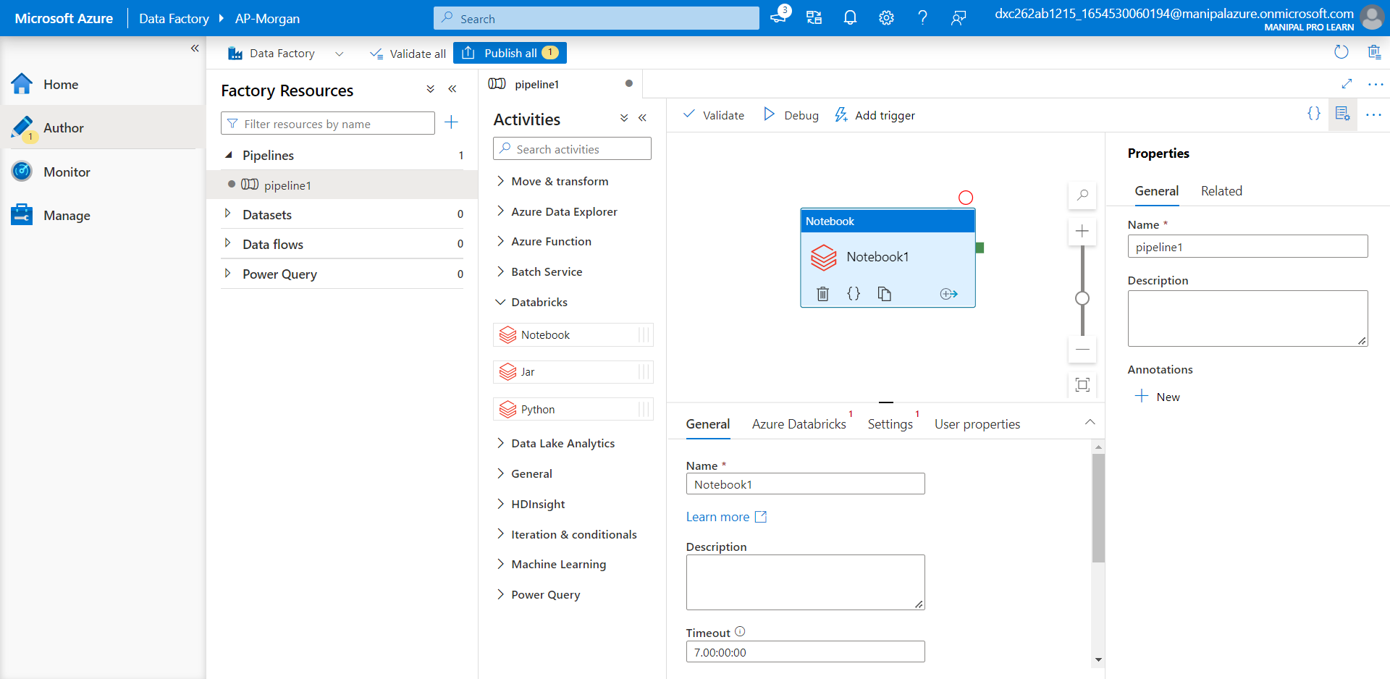
After creating a pipeline , we have to drag the notebook from databricks.

Slide 36
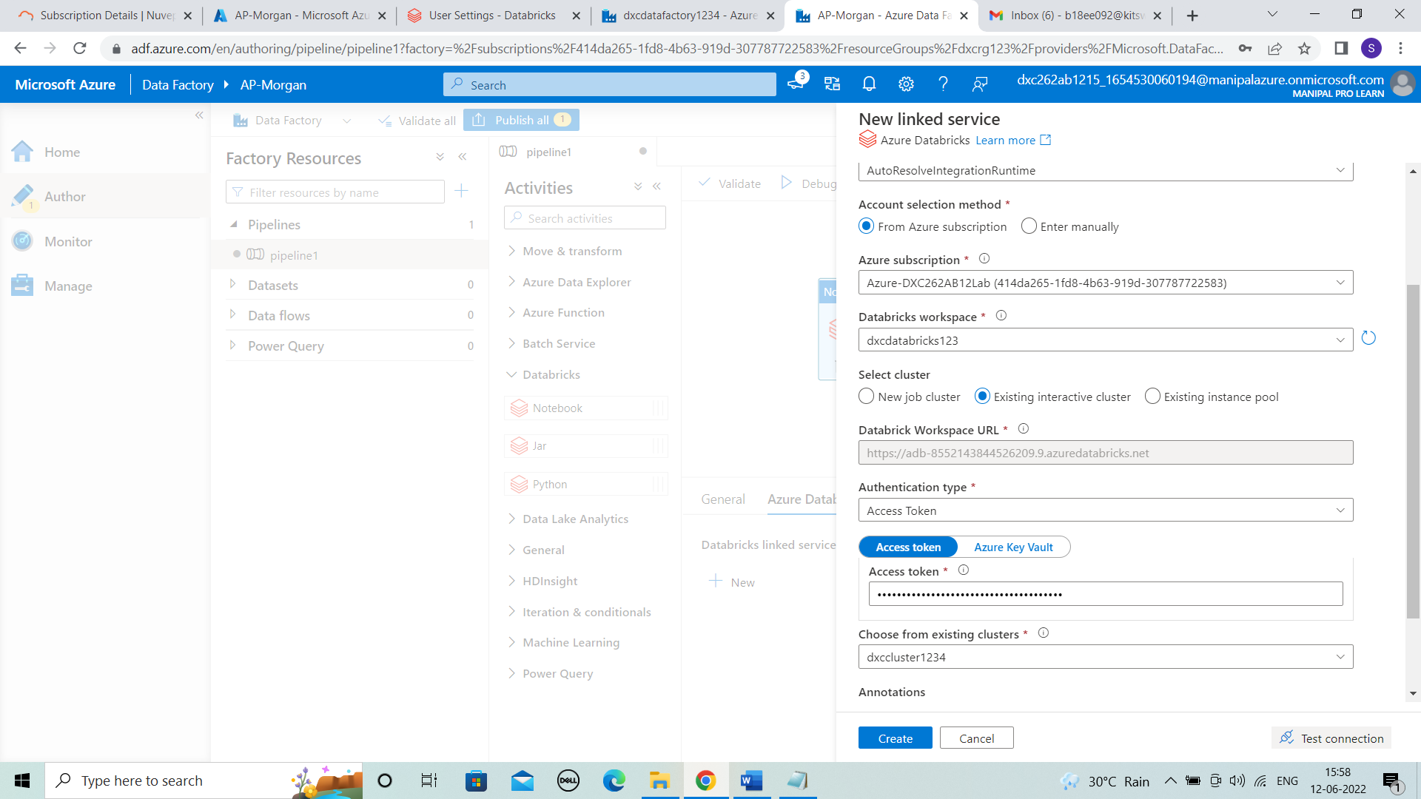
In data bricks linked service we have to enter the details shown and we need the access token.

Slide 37
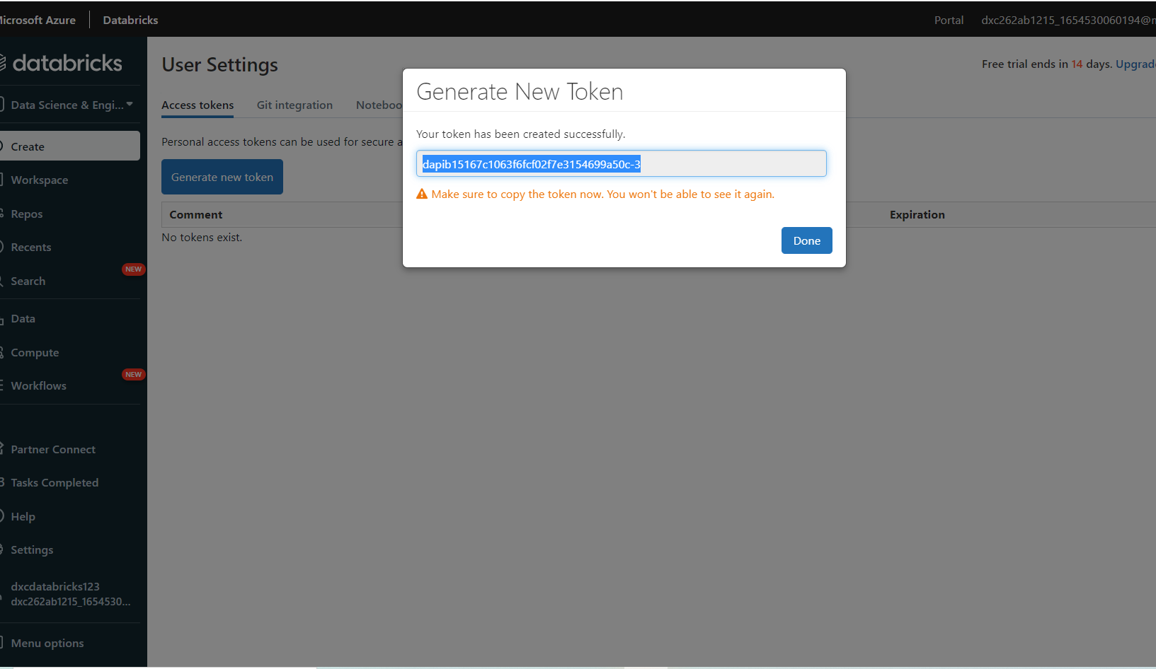
To get the token details comeback to databricks and click on settings > Usersettings > generate new token.
Enter the details Ap-morgan and lifetime then generate.

Slide 38
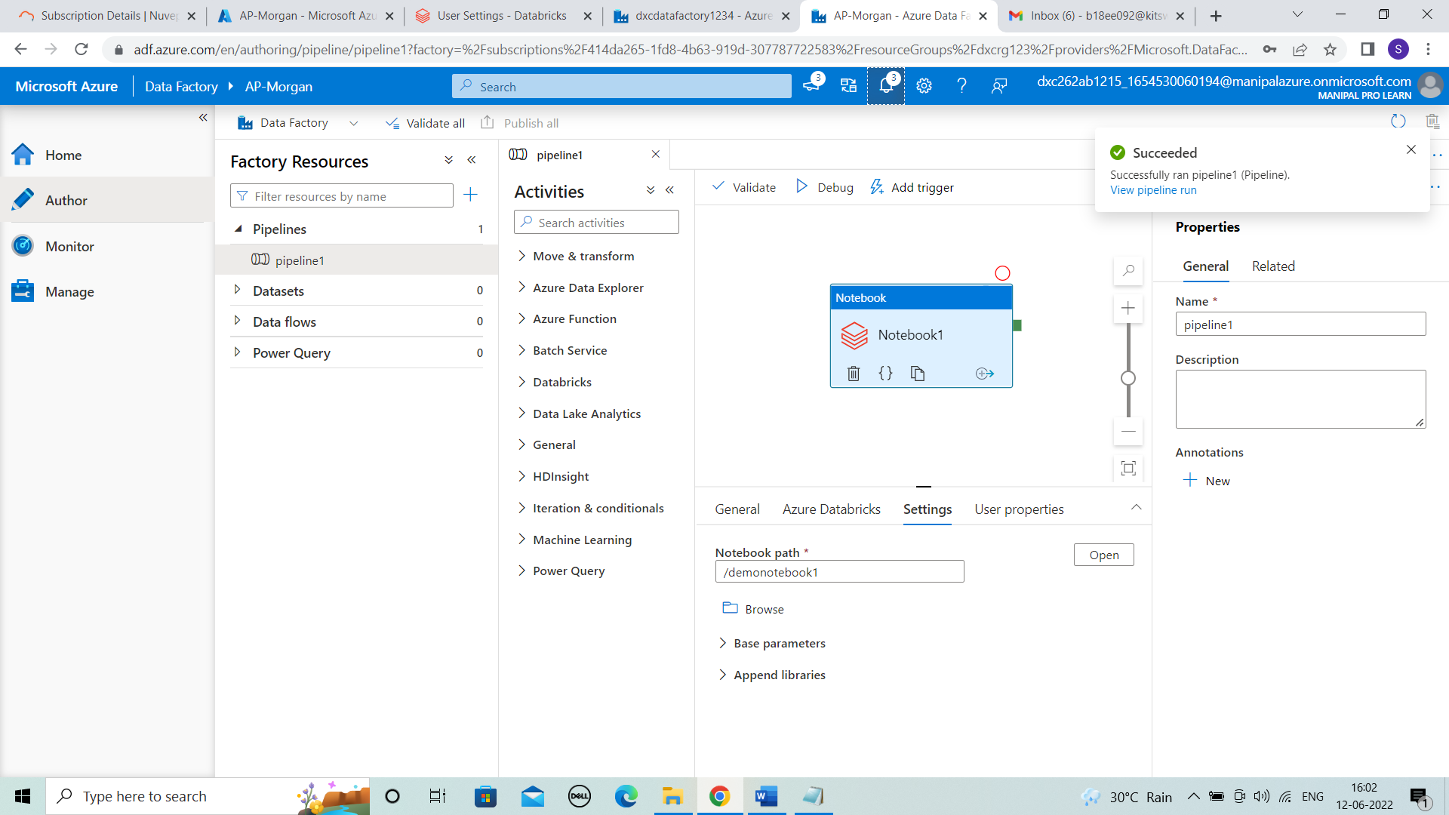
After the connection is successful , click on create.
It is successfully created then enter the notebook path by browsing.
Now validate the pipeline and then publish it. After publishing trigger the pipeline.The pipeline is successfully ran.

Slide 39
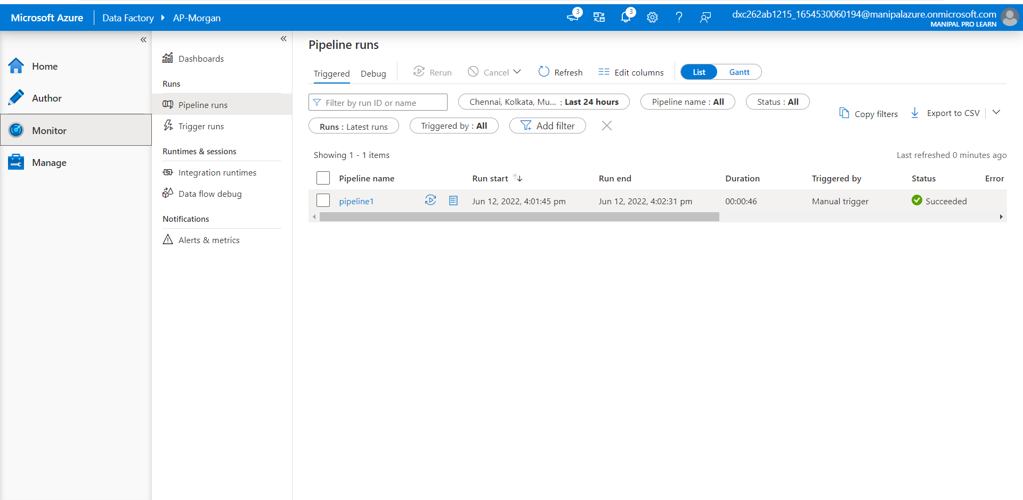
RESULT:
We can observe the pipeline runs in monitor .
We conclude it by “Azure data factory is linked with the data bricks . And notebook is triggered and ran successfully”.

Slide 40
THANK YOU!

